Slide 1
Network Security
（网络安全概述）
Dr. LU Tianbo, Professor
2018-10-08

Slide 2
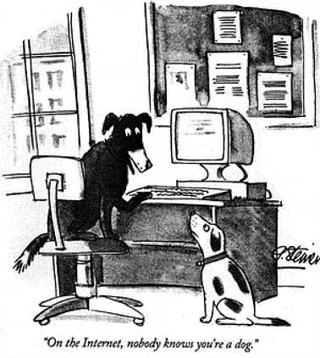

Slide 3


Slide 4


Slide 5


Slide 6
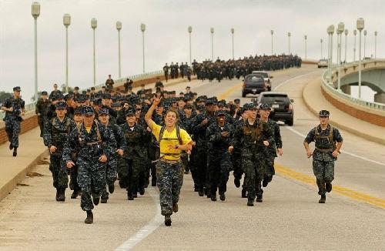

Slide 7

Notes:
最近我们在谈网络安全的事情，这又出事了。这次事情比较严重：全球超过200处机密坐标泄露，还包括48个核武器基地。
泄露这些机密的“罪魁祸首”竟是一款健身软件——Polar Flow。
来源：De Correspondent
健身软件大部分人应该都用过，可以安装在手机上，也可以安装在手表上，这样可以记录下健身速度、运动轨迹以及心率这些数据，功能非常强大，对于健身者来说非常适用，但是正因为它的这些功能，健身APP成为了泄露机密的工具。
这个健身软件让任何人都能找到数千名士兵和特工的姓名和住址
来源：De Correspondent
2018年5月9日，这是一个晴朗的早晨，一名男子在伊拉克北部的埃尔比勒国际机场进行晨跑，他很悠闲：用29分34秒跑完了约4.7公里。他手腕上的Polar V800记录下了他跑步的速度、距离、以及消耗的卡路里。
来源：De Correspondent
这名男子是一名荷兰士兵，是荷兰驻伊拉克特派团的一员。一般来说，这名士兵叫什么，住在哪里，大众肯定不知道。但是通过Polar健身应用程序中的活动地图可以轻而易举的发现这名荷兰士兵的跑步轨迹，而且可以得知他的家庭地址，甚至还能找到他妻子和孩子的名字以及照片。
像这名士兵一样使用polar健身的军人以及情报人员有很多，荷兰媒体De Correspondent通过调查发现，泄露机密的人员来自69个不同的国家，共6460人。这在6460名用户中，近90%的人在个人资料页面上列出了姓名和城市，这使得他们的家庭地址很容易暴露。
在全球6460名Polar用户的健身资料中，还原出了超过200个“机密地区”的坐标：这其中包括48处核武器储存所、18个情报机构、6处无人机基地、2处核电厂、2处皇室人员住所等。
来源：De Correspondent
而且还发现了美英法等国众多情报部门的地点：美国国家安全局（NSA）、美国特勤局（Secret Service）、英国军情六处所在的英国政府通讯总部（GCHQ）、俄总参情报总局“格鲁乌”（GRU）、俄罗斯对外情报局（SVR RF）、法国对外安全局（DGSE）以及荷兰军事情报局（MIVD）。
英国军情（MI6）
马里兰州米德堡的美国国家安全局总部
阿富汗巴格拉姆机场
De Correspondent称“只需稍稍点击几下，就可以得知存放核武的空军基地，一位军官上午在院区慢跑，我们就可以通过Polar掌握驻扎阿富汗的西方军事人员的资料，然后在社交媒体上交叉比对姓名及头像，便可确认一名士兵或军官的身份。”
中心点很可能是家庭住址
来源：De Correspondent
De Correspondent很快把这个事情通知了荷兰国防部，荷兰国防部已向外交部和情报机构发出警报。并且还将起草一项计划，禁止在个人设备上使用Polar健身APP。7月6日，Polar公司发表声明称决定将关闭定位共享功能。
Polar公司关于公共和私人运动数据的声明
来源：Polar官网
像健身APP暴露军事机密这样的事情经常发生，去年美国有一款Strava APP也是被爆出泄露军事机密，不少美军人员使用这个APP跑步，还开着定位，然后大量军事基地和隐秘据点就被曝光了。
美军在阿富汗的巴格拉姆空军基地
美国五角大楼
之前局座时评也讲到这事儿，很多土耳其士兵热衷于在网络上分享，除了发自己的自拍之外，还发一些火炮、导弹的照片和视频。这还不够，这些士兵还把自己的位置坐标给公开了。。。关键是这时候土耳其军队正在打仗中啊，这不是自己主动暴露坐标，吸引敌方火力摧毁吗。。。
技术使越来越多的事情成为可能，但同时需要我们提升安全意识。局座也一直提醒大家在未来的大数据战争里，信息安全也上升到了战略高度，每一位公民都应当自觉遵守法律，维护国家安全。

Slide 8
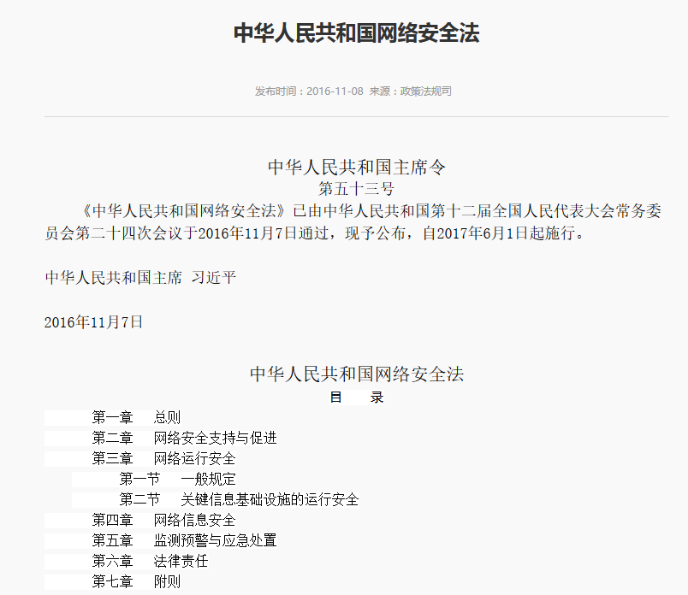

Slide 9
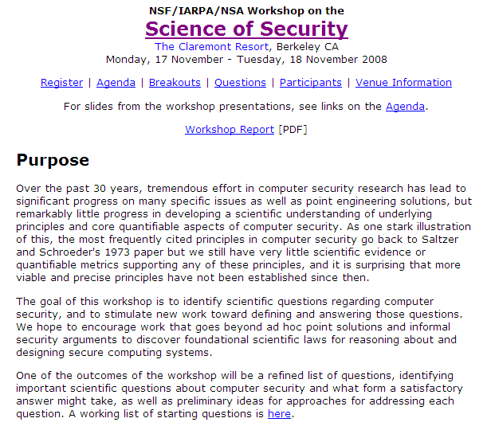
Organizers
David Evans, University of Virginia Karl Levitt, National Science Foundation Brad Martin, National Security Agency James Silk, Institute for Defense Analyses
Notes:
Organizers
David Evans, University of Virginia Karl Levitt, National Science Foundation Brad Martin, National Security Agency James Silk, Institute for Defense Analyses

Slide 10
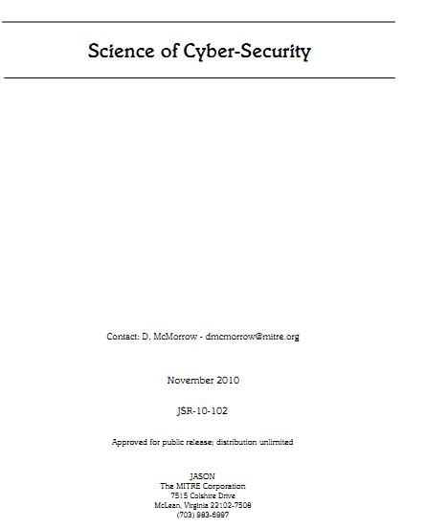
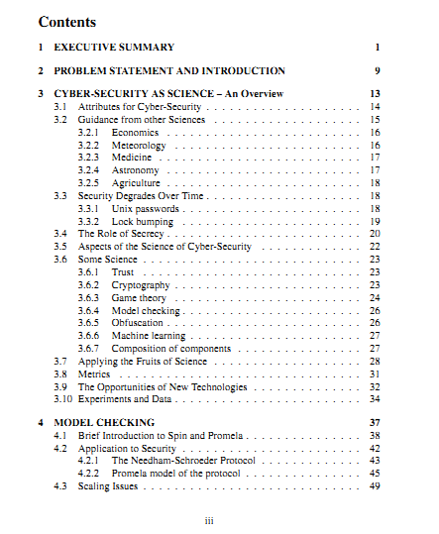

Slide 11
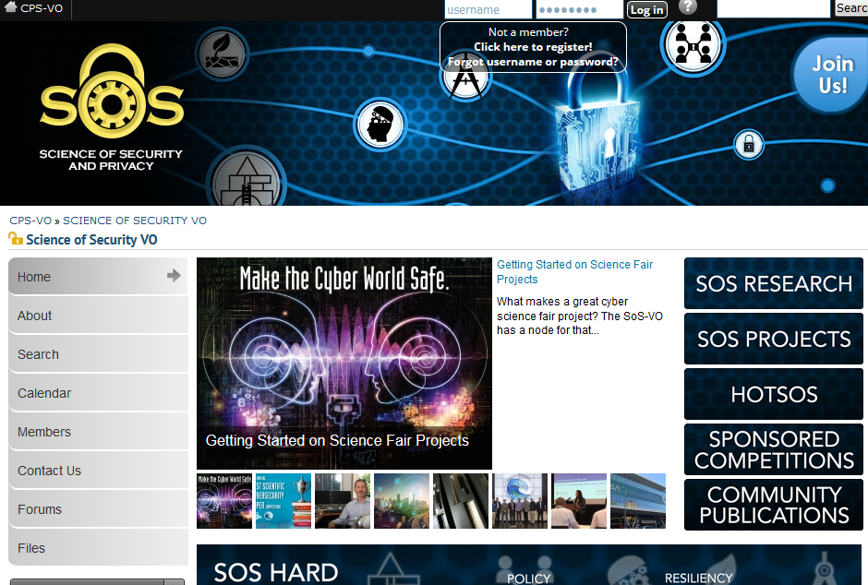
https://cps-vo.org/group/sos/
Notes:
https://cps-vo.org/group/sos/
https://seclists.org/dailydave/2014/q1/62

Slide 12
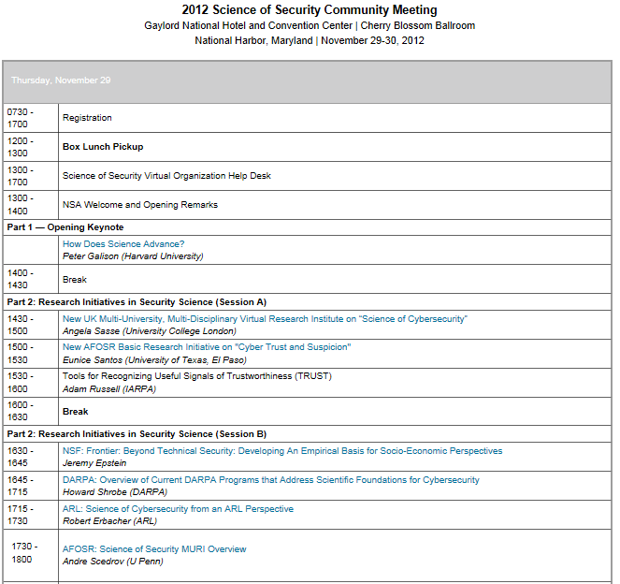
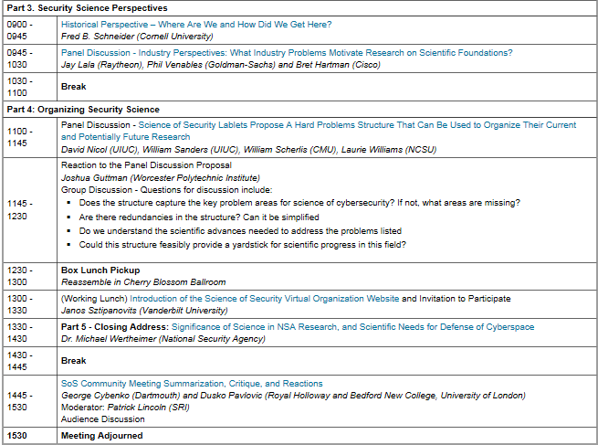

Slide 13
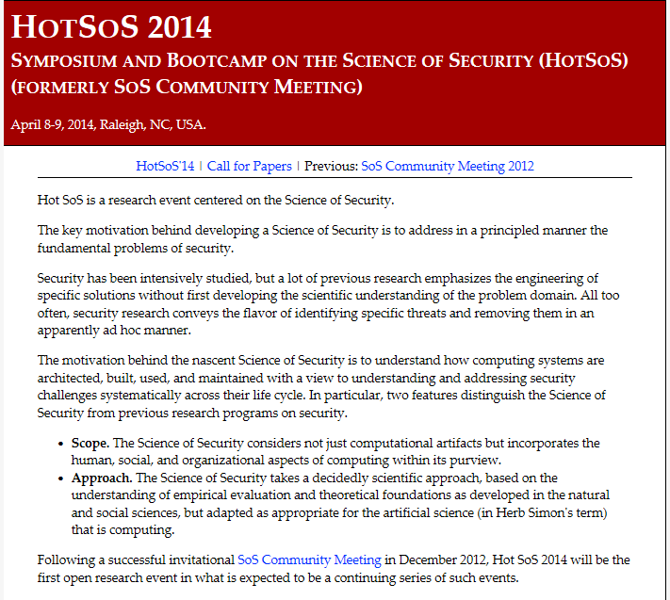
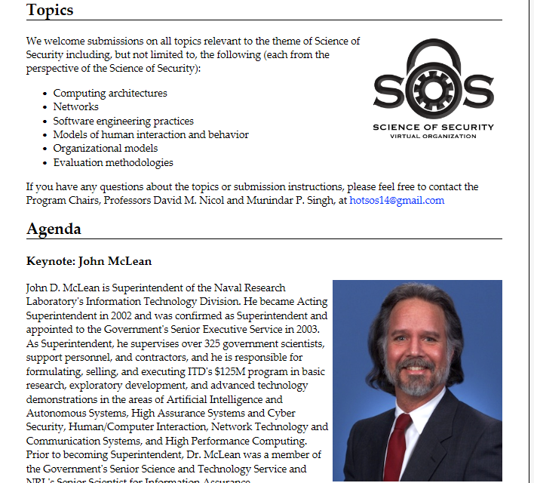
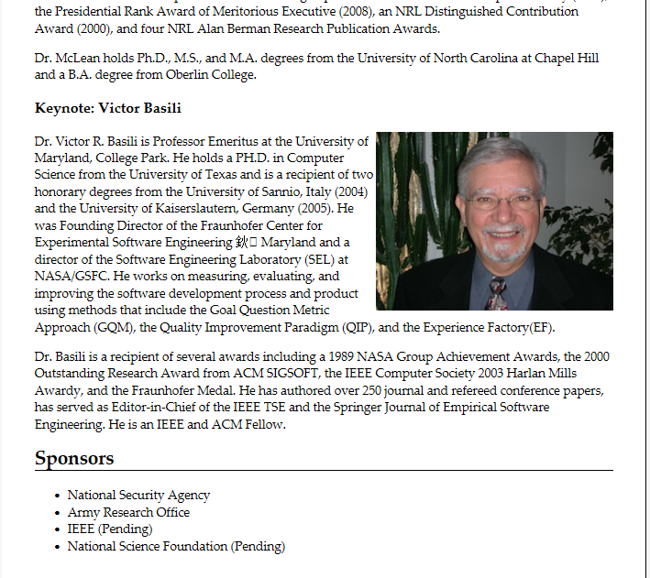

Slide 14
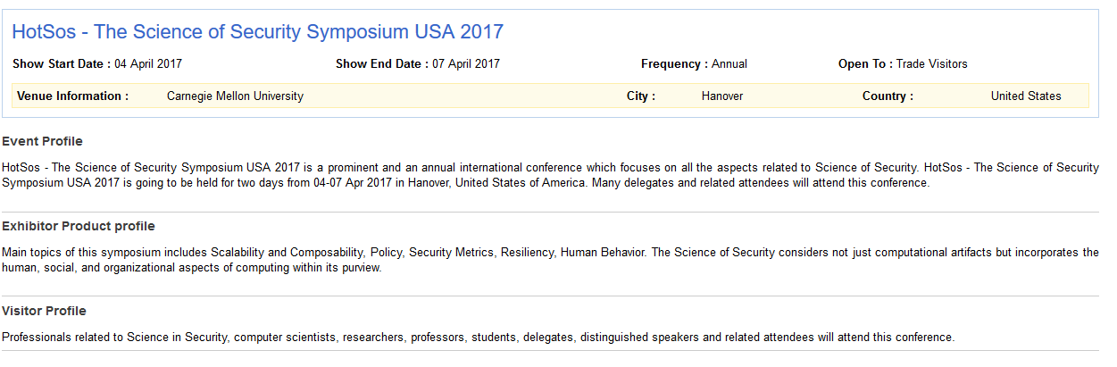
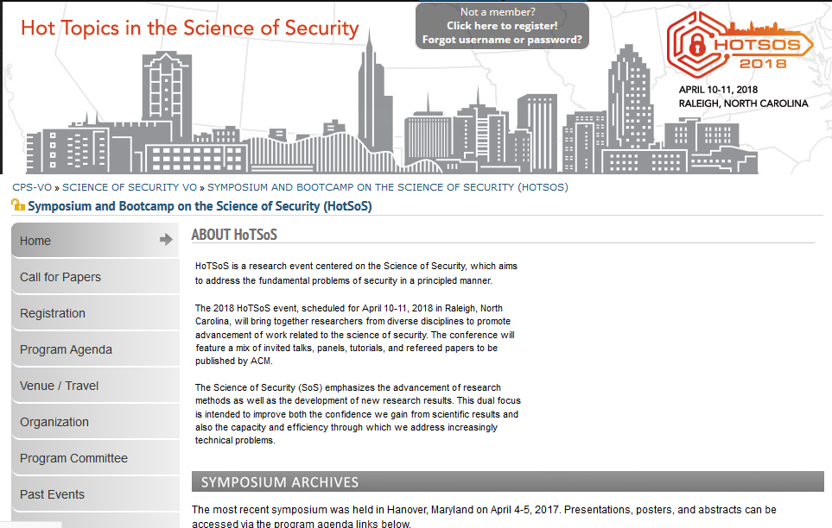

Slide 15

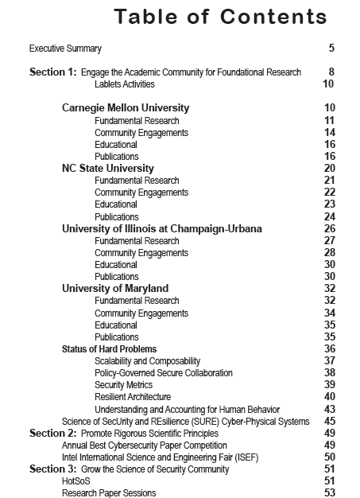

Slide 16
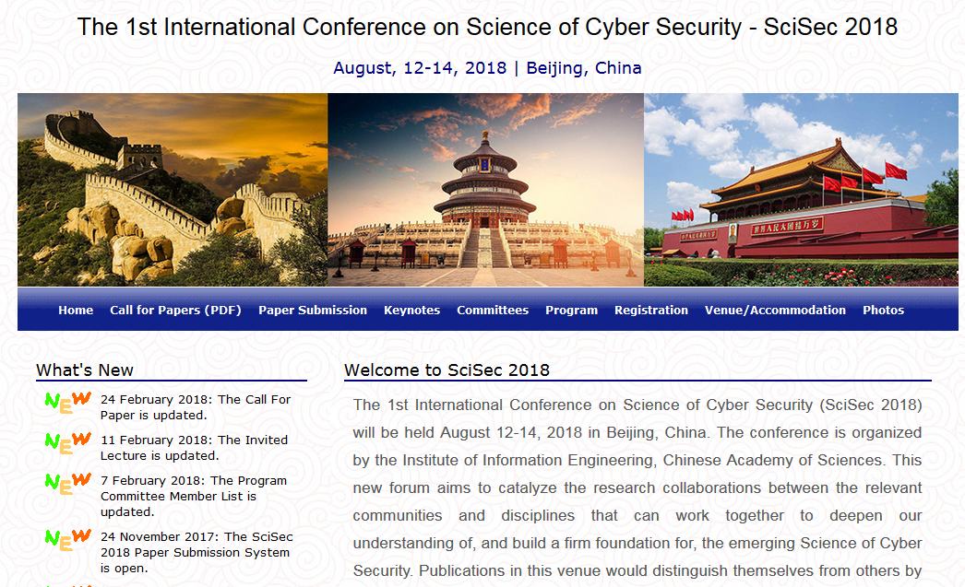
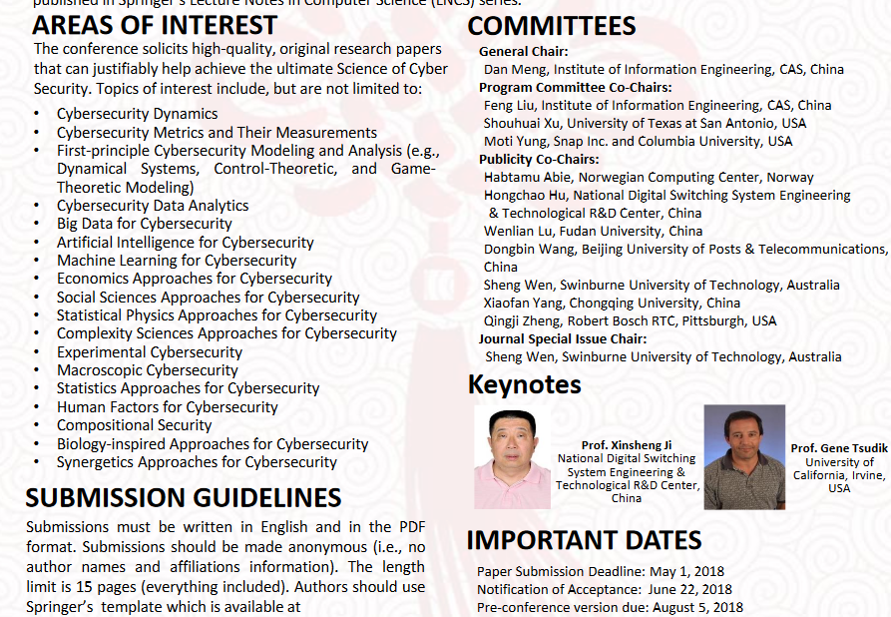

Slide 17
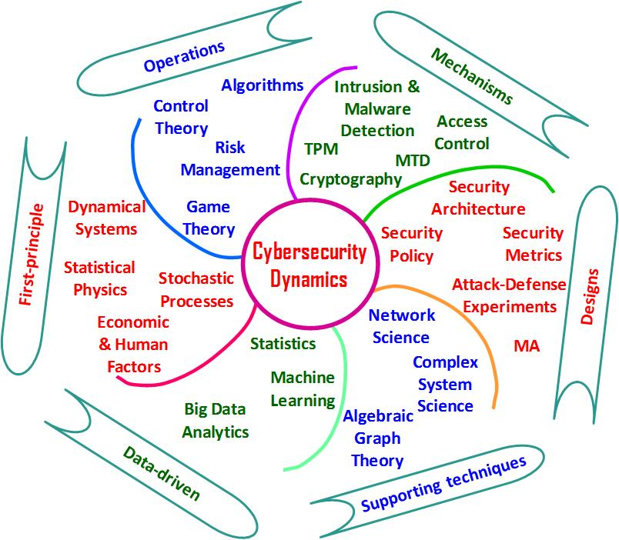

Slide 18
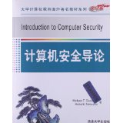
Textbook
“Introduction to Computer Security”, Michael T.Goodrich, and Roberto Tamassia, Tsinghua university press, 2013.
Several other good texts out there
Ask me if you are interested
Will supplement with other readings (distributed on class )
Notes:
Michael T.Goodrich, and Roberto Tamassia

Slide 19
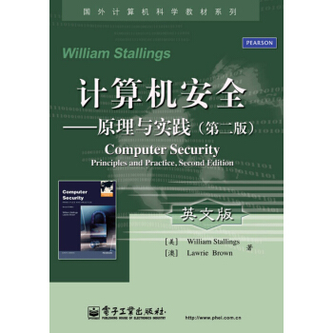
Textbook
“Computer Security Principles and Practice”, William Stallings, 机械工业出版社
Several other good texts out there
Ask me if you are interested
Will supplement with other readings (distributed on class webpage)
Notes:
Several other good texts out there
Ask me if you are interested
Will supplement with other readings (distributed on class webpage)

Slide 20
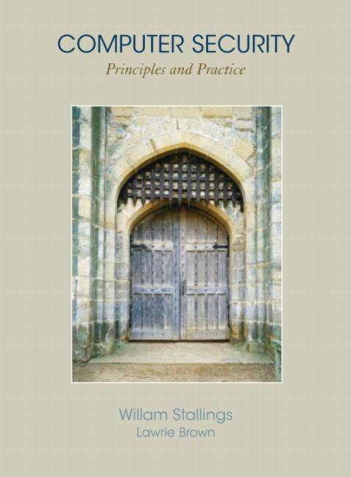
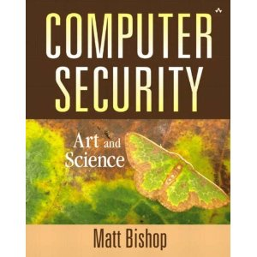

Textbook
“Computer Security Principles and Practice”, William Stallings, 机械工业出版社
Several other good texts out there
Ask me if you are interested
Will supplement with other readings (distributed on class webpage)
Notes:
Several other good texts out there
Ask me if you are interested
Will supplement with other readings (distributed on class webpage)

Slide 21
Defining Security
The security of a system, application, or protocol is always relative to
A set of desired properties
An adversary with specific capabilities
For example, standard file access permissions in Linux and Windows are not effective against an adversary who can boot from a CD

Slide 22

Security Goals
Integrity
Classically, Information Security has been defined in terms of the CIA model.
C.I.A.
Confidentiality
Availability

Slide 23
Confidentiality
The first important aspect of information security is confidentiality.
Confidentiality is the avoidance of the unauthorized disclosure of information.
confidentiality involves the protection of data, providing access for those who are allowed to see it while disallowing others from learning anything about its content.
Notes:
The first important aspect of information security is confidentiality.

Slide 24
Tools for Confidentiality
Encryption: the transformation of information using a secret, called an encryption key, so that the transformed information can only be read using another secret, called the decryption key (which may, in some cases, be the same as the encryption key).
Sender
Communication channel
Recipient
encrypt
decrypt
ciphertext
plaintext
plaintext
shared
secret
key
shared
secret
key
Attacker
(eavesdropping)

Slide 25
Tools for Confidentiality
Access control: rules and policies that limit access to confidential information to those people and/or systems with a “need to know.”
This need to know may be determined by identity, such as a person’s name or a computer’s serial number, or by a role that a person has, such as being a manager or a computer security specialist.

Slide 26
Tools for Confidentiality
Authentication: the determination of the identity or role that someone has. This determination can be done in a number of different ways, but it is usually based on a combination of
something the person has (like a smart card or a radio key fob storing secret keys),
something the person knows (like a password),
something the person is (like a human with a fingerprint).
password=ucIb()w1V
mother=Jones
pet=Caesar
human with fingers
and eyes
Something you are
Something you know
radio token with
secret keys
Something you have

Slide 27
Tools for Confidentiality
Authorization: the determination if a person or system is allowed access to resources, based on an access control policy.
Such authorizations should prevent an attacker from tricking the system into letting him have access to protected resources.
Physical security: the establishment of physical barriers to limit access to protected computational resources.
Such barriers include locks on cabinets and doors, the placement of computers in windowless rooms, the use of sound dampening materials, and even the construction of buildings or rooms with walls incorporating copper meshes (called Faraday cages) so that electromagnetic signals cannot enter or exit the enclosure.
Notes:
Confidentiality，Integrity，Availability，Anonymity

Slide 28
Integrity
Another important aspect of information security is integrity.
Integrity: the property that information has not be altered in an unauthorized way.
Tools:
Backups: the periodic archiving of data.
Checksums: the computation of a function that maps the contents of a file to a numerical value. A checksum function depends on the entire contents of a file and is designed in a way that even a small change to the input file (such as flipping a single bit) is highly likely to result in a different output value.
Data correcting codes: methods for storing data in such a way that small changes can be easily detected and automatically corrected.

Slide 29
Availability
The third leg of support for the vital C.I.A. model is availability
Availability: the property that information is accessible and modifiable in a timely fashion by those authorized to do so.
Tools:
Physical protections: infrastructure meant to keep information available even in the event of physical challenges.
Computational redundancies: computers and storage devices that serve as fallbacks in the case of failures.

Slide 30
Other Security Concepts
In addition to the classic CIA concepts of confidentiality, integrity, and availability, there are a number of additional concepts that are also important on modern computer security applications.
A.A.A.
Authenticity
Anonymity
Assurance

Slide 31
Assurance
Assurance refers to how trust is provided and managed in computer systems.
Trust management depends on:
Policies, which specify behavioral expectations that people or systems have for themselves and others.
For example, the designers of an online music system may specify policies that describe how users can access and copy songs.
Permissions, which describe the behaviors that are allowed by the agents that interact with a person or system.
For instance, an online music store may provide permissions for limited access and copying to people who have purchased certain songs.
Protections, which describe mechanisms put in place to enforce permissions and polices.
We could imagine that an online music store would build in protections to prevent people from unauthorized access and copying of its songs.

Slide 32
Authenticity
Authenticity is the ability to determine that statements, policies, and permissions issued by persons or systems are genuine.
Primary tool:
digital signatures. These are cryptographic computations that allow a person or system to commit to the authenticity of their documents in a unique way that achieves nonrepudiation, which is the property that authentic statements issued by some person or system cannot be denied.

Slide 33
Anonymity
Anonymity: the property that certain records or transactions not to be attributable to any individual.
Tools:
Aggregation: the combining of data from many individuals so that disclosed sums or averages cannot be tied to any individual.
Mixing: the intertwining of transactions, information, or communications in a way that cannot be traced to any individual.
Proxies: trusted agents that are willing to engage in actions for an individual in a way that cannot be traced back to that person.
Pseudonyms: fictional identities that can fill in for real identities in communications and transactions, but are otherwise known only to a trusted entity.

Slide 34
Threats and Attacks
Eavesdropping（窃听）: the interception of information intended for someone else during its transmission over a communication channel.
Alice
Bob
Eve

Slide 35

Threats and Attacks
Alteration（修改）: unauthorized modification of information.
Example: the man-in-the-middle attack, where a network stream is intercepted, modified, and retransmitted.
Sender
Communication channel
Recipient
encrypt
decrypt
plaintext M
plaintext M′
shared
secret
key
shared
secret
key
ciphertext C
ciphertext C′
Attacker
(intercepting)

Slide 36
Threats and Attacks
Denial-of-service（拒绝服务）: the interruption or degradation of a data service or information access.
Example: email spam, to the degree that it is meant to simply fill up a mail queue and slow down an email server.
Alice

Slide 37
SPAM

Slide 38
Email Bomber

Slide 39
mailbox

Slide 40
Threats and Attacks
Masquerading（伪造）: the fabrication of information that is purported to be from someone who is not actually the author.
“From: Alice”
(really is from Eve)

Slide 41
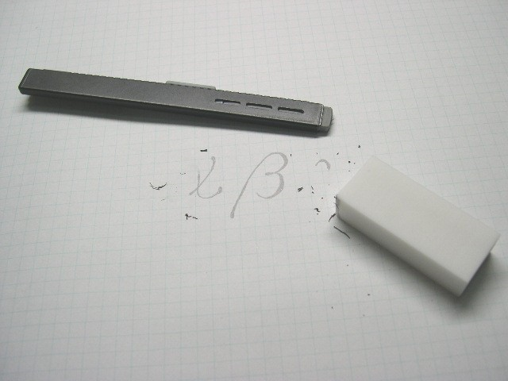
Threats and Attacks
Repudiation（否认）: the denial of a commitment or data receipt.
This involves an attempt to back out of a contract or a protocol that requires the different parties to provide receipts acknowledging that data has been received.
Public domain image from http://commons.wikimedia.org/wiki/File:Plastic_eraser.jpeg

Slide 42
Threats and Attacks
Correlation（关联） and traceback（追踪）: the integration of multiple data sources and information flows to determine the source of a particular data stream or piece of information.
Bob

Slide 43
The Ten Security Principles
Security Principles
Economy of mechanism
Fail-safe defaults
Complete mediation
Open design
Separation of privilege
Least privilege
Least common mechanism
Psychological acceptability
Work factor
Compromise recording

Slide 44
Economy of mechanism （机制的经济性）
This principle stresses simplicity in the design and implementation of security measures.
While applicable to most engineering endeavors, the notion of simplicity is especially important in the security domain, since a simple security framework facilitates its understanding by developers and users and enables the efficient development and verification of enforcement methods for it.

Slide 45
Fail-safe defaults（故障安全默认）
This principle states that the default configuration of a system should have a conservative protection scheme.
For example, when adding a new user to an operating system, the default group of the user should have minimal access rights to files and services. Unfortunately, operating systems and applications often have default options that favor usability over security.
This has been historically the case for a number of popular applications, such as web browsers that allow the execution of code downloaded from the web server.

Slide 46
Complete mediation（完全仲裁）
The idea behind this principle is that every access to a resource must be checked for compliance with a protection scheme.
As a consequence, one should be wary of performance improvement techniques that save the results of previous authorization checks, since permissions can change over time.
For example, an online banking web site should require users to sign on again after a certain amount of time, say, 15 minutes, has elapsed.

Slide 47
Open design（设计开放）
According to this principle, the security architecture and design of a system should be made publicly available.
Security should rely only on keeping cryptographic keys secret.
Open design allows for a system to be scrutinized by multiple parties, which leads to the early discovery and correction of security vulnerabilities caused by design errors.
The open design principle is the opposite of the approach known as security by obscurity(不公开即安全), which tries to achieve security by keeping cryptographic algorithms secret and which has been historically used without success by several organizations.

Slide 48
Separation of privilege （特权分离）
This principle dictates that multiple conditions should be required to achieve access to restricted resources or have a program perform some action.

Slide 49
Least privilege（最小特权）
Each program and user of a computer system should operate with the bare minimum privileges necessary to function properly.
If this principle is enforced, abuse of privileges is restricted, and the damage caused by the compromise of a particular application or user account is minimized.
The military concept of need-to-know information is an example of this principle.

Slide 50
Least common mechanism （最少公共机制）
In systems with multiple users, mechanisms allowing resources to be shared by more than one user should be minimized.
For example, if a file or application needs to be accessed by more than one user, then these users should have separate channels by which to access these resources, to prevent unforeseen consequences that could cause security problems.

Slide 51
Psychological acceptability （心里可接受）
This principle states that user interfaces should be well designed and intuitive, and all security-related settings should adhere to what an ordinary user might expect.

Slide 52
Work factor （工作因素）
According to this principle, the cost of circumventing a security mechanism should be compared with the resources of an attacker when designing a security scheme.
A system developed to protect student grades in a university database, which may be attacked by snoopers or students trying to change their grades, probably needs less sophisticated security measures than a system built to protect military secrets, which may be attacked by government intelligence organizations.

Slide 53
Compromise recording （危害记录）
This principle states that sometimes it is more desirable to record the details of an intrusion than to adopt more sophisticated measures to prevent it.
Internet-connected surveillance cameras are a typical example of an effective compromise record system that can be deployed to protect a building in lieu of reinforcing doors and windows.
The servers in an office network may maintain logs for all accesses to files, all emails sent and received, and all web browsing sessions.

Slide 54
Topic: Access Control
Users and groups
Authentication
Passwords
File protection
Access control lists
Which users can read/write which files?
Are my files really safe?
What does it mean to be root?
What do we really want to control?

Slide 55
Access Control Matrices
A table that defines permissions.
Each row of this table is associated with a subject, which is a user, group, or system that can perform actions.
Each column of the table is associated with an object, which is a file, directory, document, device, resource, or any other entity for which we want to define access rights.
Each cell of the table is then filled with the access rights for the associated combination of subject and object.
Access rights can include actions such as reading, writing, copying, executing, deleting, and annotating.
An empty cell means that no access rights are granted.

Slide 56
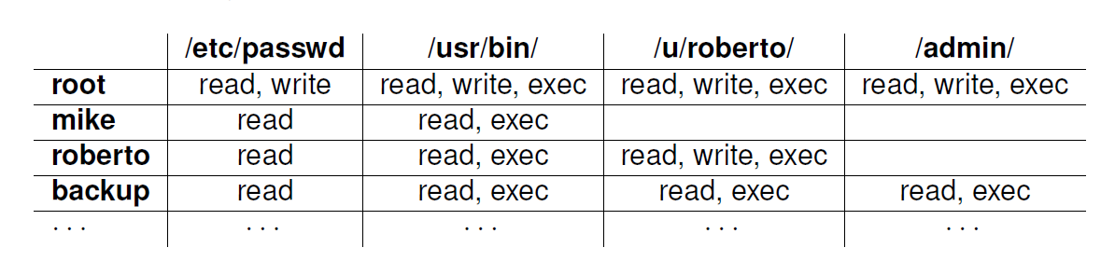
Example Access Control Matrix
This table lists read, write, and execution (exec) access rights for each of four fictional users with respect to one file, /etc/passwd, and three directories.

Slide 57
Access Control Lists
It defines, for each object, o, a list, L, called o’s access control list, which enumerates all the subjects that have access rights for o and, for each such subject, s, gives the access rights that s has for object o.
/etc/passwd
/usr/bin/
/u/roberto/
/admin/
root: r,w
mike: r
roberto: r
backup: r
root: r,w,x
mike: r,x
roberto: r,x
backup: r,x
root: r,w,x
roberto: r,w,x
backup: r,x
root: r,w,x
backup: r,x

Slide 58
Capabilities
/etc/passwd: r,w,x; /usr/bin: r,w,x;
/u/roberto: r,w,x; /admin/: r,w,x
root
Takes a subject-centered approach to access control. It defines, for each subject s, the list of the objects for which s has nonempty access control rights, together with the specific rights for each such object.
mike
/usr/passwd: r; /usr/bin: r,x
/usr/passwd: r; /usr/bin: r;
/u/roberto: r,w,x
roberto
/etc/passwd: r,x; /usr/bin: r,x;
/u/roberto: r,x; /admin/: r,x
backup

Slide 59
Role-based Access Control
Define roles and then specify access control rights for these roles, rather than for subjects directly.
Department Chair
Administrative Manager
Lab Manager
System Administrator
Undergraduate TA
Graduate TA
Accountant
Secretary
Lab Technician
Backup Agent
Undergraduate Student
Graduate Student
Administrative Personnel
Technical Personnel
Faculty
Student
Department Member

Slide 60
Cryptographic Concepts
Encryption: a means to allow two parties, customarily called Alice and Bob, to establish confidential communication over an insecure channel that is subject to eavesdropping.
Alice
Bob
Eve

Slide 61
Encryption and Decryption
The message M is called the plaintext.
Alice will convert plaintext M to an encrypted form using an encryption algorithm E that outputs a ciphertext C for M.
Sender
Communication channel
Recipient
encrypt
decrypt
ciphertext
plaintext
plaintext
shared
secret
key
shared
secret
key
Attacker
(eavesdropping)

Slide 62
Encryption and Decryption
As equations:
C = E(M)
M = D(C)
The encryption and decryption algorithms are chosen so that it is infeasible for someone other than Alice and Bob to determine plaintext M from ciphertext C. Thus, ciphertext C can be transmitted over an insecure channel that can be eavesdropped by an adversary.

Slide 63
Cryptosystem
The set of possible plaintexts
The set of possible ciphertexts
The set of encryption keys
The set of decryption keys
The correspondence between encryption keys and decryption keys
The encryption algorithm to use
The decryption algorithm to use

Slide 64
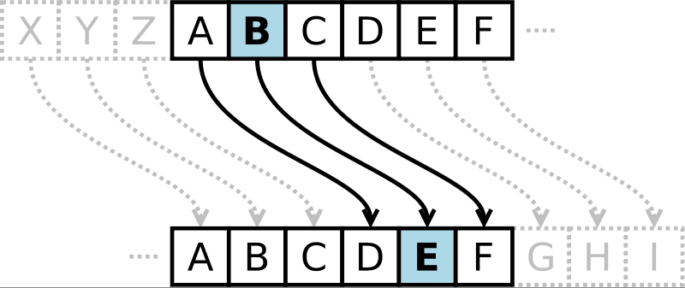
Caesar Cipher
Replace each letter with the one “three over” in the alphabet.
Public domain image from http://commons.wikimedia.org/wiki/File:Caesar3.svg

Slide 65
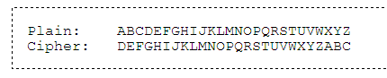
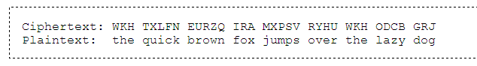

Slide 66
Please recover the original plaintext from the following ciphertext :
Pdqb qljkwv zh kdyh sudbhg
Zlwk qr surri dqbrqh frxog khdu
Dqg rxu khduwv d krshixo vrqj
Zh eduhob xqghuvwrrg
Qrz zh duh qrw diudlg
Dowkrxjk zh nqrz wkhuh lv pxfk wr ihdu
Zh zhuh prylqj prxqwdlqv orqj
Ehiruh zh nqhz zh frxog
Wkhuh fdq eh pludfohv zkhq brx eholhyh
Wkrxjk krsh lv iudlo
Lw lv kdug wr nloo
Zkr nqrzv zkdw pludfohv brx fdq dfklhyh
Zkhq brx eholhyh vrphkrz brx zloo
Brx zloo zkhq brx eholhyh

Slide 67
Symmetric Cryptosystems
Alice and Bob share a secret key, which is used for both encryption and decryption. An attacker who eavesdrops the communications channel cannot decrypt the ciphertext without knowing the key.
Sender
Communication channel
Recipient
encrypt
decrypt
ciphertext
plaintext
plaintext
shared
secret
key
shared
secret
key
Attacker
(eavesdropping)

Slide 68
Symmetric Key Distribution
Pairwise confidential communication among n users with a symmetric cryptosystem requires ??? Distinct keys, each shared by two users and kept secret from the other users.
shared
secret
shared
secret
shared
secret
shared
secret
shared
secret
n (n−1)/2 keys
shared
secret

Slide 69
Public-Key Cryptography
Bob has two keys: a private key, SB, which Bob keeps secret, and a public key, PB, which Bob broadcasts widely.
In order for Alice to send an encrypted message to Bob, she need only obtain his public key, PB, use that to encrypt her message, M, and send the result, C = E_{PB} (M), to Bob. Bob then uses his secret key to decrypt the message as M = D_{SB} (C).

Slide 70
Public-Key Cryptography
In a public-key cryptosystem, the sender uses the public key of the recipient to encrypt and the recipient uses its private key to decrypt. An attacker who eavesdrops the communication channel cannot decrypt the ciphertext without knowing the private key.
Communication channel
Sender
Recipient
encrypt
decrypt
plaintext
ciphertext
plaintext
plaintext
public
key
private
key
Attacker
(eavesdropping)
Notes:
Separate keys are used for encryption and decryption.

Slide 71
Public Key Distribution
Pairwise confidential communication among n users with a public-key cryptosystem requires ??? Key pairs, one per user.
private
private
public
public
n key pairs
public
public
private
private
Notes:
Only one key is needed for each recipient

Slide 72
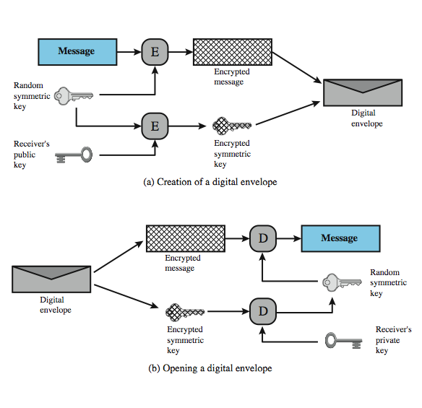
Digital Envelopes
Suppose Bob wishes to send a confidential message to Alice, but they do not share a symmetric secret key. Bob does the following:
1. Prepare a message
2. Encrypt that message using conventional encryption with a session key.
3. Encrypt the session key using public-key encryption with Alice's public key.
4. Attach the encrypted session key to the message and send it to Alice.
Only Alice is capable of decrypting the session key and therefore of recovering the original message. If Bob obtained Alice‘s public key by means of Alice’s public-key certificate, then Bob is assured that it is a valid key.
Notes:
Another application in which public-key encryption is used to protect a symmetric key is the digital envelope, which can be used to protect a message without needing to first arrange for sender and receiver to have the same secret key. The technique is referred to as a digital envelope, which is the equivalent of a sealed envelope containing an unsigned letter. The general approach is shown here from Figure 2.9 in the text. Suppose Bob wishes to send a confidential message to Alice, but they do not share a symmetric secret key. Bob does the following:
1. Prepare a message
2. Encrypt that message using conventional encryption with a one-time conventional session key.
3. Encrypt the session key using public-key encryption with Alice's public key.
4. Attach the encrypted session key to the message and send it to Alice.
Only Alice is capable of decrypting the session key and therefore of recovering the original message. If Bob obtained Alice's public key by means of Alice's public-key certificate, then Bob is assured that it is a valid key.

Slide 73
Digital Signatures
Public-key encryption provides a method for doing digital signatures
To sign a message, M, Alice just encrypts it with her private key, SA, creating C = E_{SA}(M).
Anyone can decrypt this message using Alice’s public key, as M’ = D_{PA}(C), and compare that to the message M.

Slide 74
Cryptographic Hash Functions
A checksum on a message, M, that is:
One-way: it should be easy to compute Y=H(M), but hard to find M given only Y
Collision-resistant: it should be hard to find two messages, M and N, such that H(M)=H(N).
Examples: SHA-1, SHA-256.

Slide 75

Message Authentication Codes
Allows for Alice and Bob to have data integrity, if they share a secret key.
Given a message M, Alice computes H(K||M) and sends M and this hash to Bob.
Communication channel
(attack detected) =?
h
6B34339
4C66809
4C66809
87F9024
h
message M
MAC
MAC
received MAC
computed MAC
message M’
shared
secret
key
shared
secret
key
Sender
Attacker
(modifying)
Recipient

Slide 76
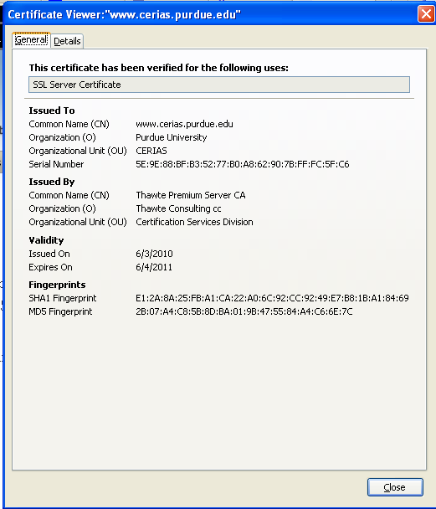
Digital Certificates
certificate authority (CA) digitally signs a binding between an identity and the public key for that identity.

Slide 77
Passwords
A short sequence of characters used as a means to authenticate someone via a secret that they know.
Userid: _________________
Password: ______________

Slide 78
How a password is stored?
User
Password file
Dog124
Butch:ASDSA
21QW3R50E
ERWWER323
…
…
hash function

Slide 79
Strong Passwords
What is a strong password
UPPER/lower case characters
Special characters
Numbers
When is a password strong?
Seattle1
M1ke03
P@$$w0rd
TD2k5secV
Notes:
Spostare in altra sezione

Slide 80
Password Complexity
A fixed 6 symbols password:
Numbers 10⁶ = 1,000,000
UPPER or lower case characters 26⁶ = 308,915,776
UPPER and lower case characters 52⁶ = 19,770,609,664
32 special characters (&, %, $, £, “, |, ^, §, etc.) 32⁶ = 1,073,741,824
94 practical symbols available
94⁶ = 689,869,781,056
ASCII standard 7 bit 2⁷ =128 symbols
128⁶ = 4,398,046,511,104
Notes:
The number of potential passwords is 94⁶ = 689,869,781,056

Slide 81

Password Length
26 UPPER/lower case characters = 52 characters
10 numbers
32 special characters
=> 94 characters available
5 characters: 94⁵ = 7,339,040,224
6 characters: 94⁶ = 689,869,781,056
7 characters: 94⁷ = 64,847,759,419,264
8 characters: 94⁸ = 6,095,689,385,410,816
9 characters: 94⁹ = 572,994,802,228,616,704
Notes:
The number of potential passwords is 94⁸ = 6,095,689,385,410,816

Slide 82
Password Validity: Brute Force Test
Password does not change for 60 days
how many passwords should I try for each second?
5 characters: 1,415 PW /sec
6 characters: 133,076 PW /sec
7 characters: 12,509,214 PW /sec
8 characters: 1,175,866,008 PW /sec
9 characters: 110,531,404,750 PW /sec

Slide 83
Brute Force Search
always possible to simply try every key
most basic attack, proportional to key size
assume either know / recognise plaintext
Key Size (bits) | Number of Alternative Keys | Time required at 1 decryption/µs | Time required at 10⁶ decryptions/µs
32 | 2³² = 4.3 × 10⁹ | 2³¹ µs = 35.8 minutes | 2.15 milliseconds
56 | 2⁵⁶ = 7.2 × 10¹⁶ | 2⁵⁵ µs = 1142 years | 10.01 hours
128 | 2¹²⁸ = 3.4 × 10³⁸ | 2¹²⁷ µs = 5.4 × 10²⁴ years | 5.4 × 10¹⁸ years
168 | 2¹⁶⁸ = 3.7 × 10⁵⁰ | 2¹⁶⁷ µs = 5.9 × 10³⁶ years | 5.9 × 10³⁰ years
26 characters (permutation) | 26! = 4 × 10²⁶ | 2 × 10²⁶ µs = 6.4 × 10¹² years | 6.4 × 10⁶ years
Notes:
A brute-force attack involves trying every possible key until an intelligible translation of the ciphertext into plaintext is obtained. On average, half of all possible keys must be tried to achieve success. The Table shows how much time is required to conduct a brute-force attack, for various common key sizes (DES is 56, AES is 128, Triple-DES is 168, plus general mono-alphabetic cipher), where either a single system or a million parallel systems, are used.

Slide 84
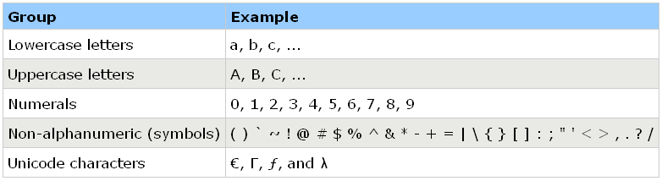
Secure Passwords
A strong password includes characters from at least three of the following groups:
Use pass phrases eg. "I re@lly want to buy 11 Dogs!"

Slide 85
Social Engineering
Pretexting（假托）: creating a story that convinces an administrator or operator into revealing secret information.
Baiting（诱饵）: offering a kind of “gift” to get a user or agent to perform an insecure action.
Quid pro quo（相等补偿）: offering an action or service and then expecting something in return.

